Slide 1
Development of Analysis Techniques for Dynamic Magnetic Resonance Imaging of the Knee
Master Thesis Defense
Medical Photonics
Application to Tibiofemoral Kinematics
Jena | 25.10.2024 | Aayush Nepal | 198683 | Sumbitted on June 11, 2024

Slide 2
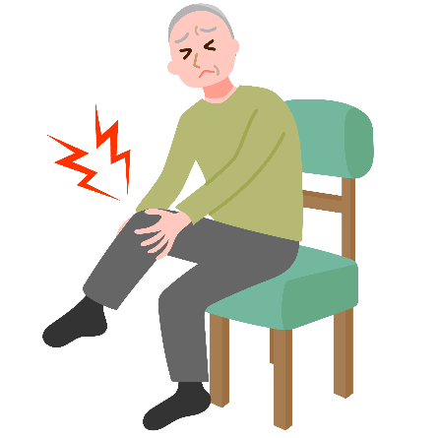
Motivation: Relevance of knee kinematics
Knee osteoarthritis (OA) affects 10% men and 13% of women aged 60 and older (Zhang et al., 2010)
Altered tibiofemoral kinematics in OA patients can potentially accelerate disease progression (Farrokhi et al., 2014)
Even in ACL-deficient knees without instability symptoms show altered kinematics (Yang et al., 2018)
Increased anterior tibial translation during controlled knee extension (Barrance et al., 2006)
These alterations can lead to abnormal joint loading and tissue strains (Chaudhari et al., 2008)
Dynamic MRI is a promising tool to study such kinematics in vivo
Jena | 25.10.2024 | Aayush Nepal

Slide 3
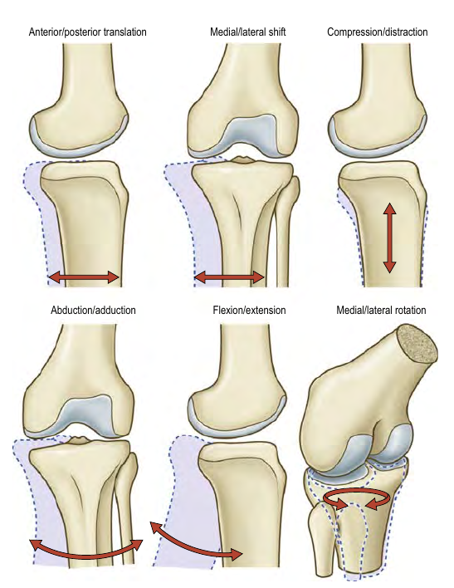
Tibiofemoral kinematics
Six Degrees of freedom
3 Rotations
Flexion-Extension
Medial-Lateral
Abduction-Adduction
3 Translations
Anterior-Posterior
Meidal-Lateral
Compression-Distraction
(Credit: Gray’s Anatomy 42nd ed.)
Jena | 25.10.2024 | Aayush Nepal
Notes:
If we can quantify any one of these motions accurately, then vital information might be revealed.

Slide 4
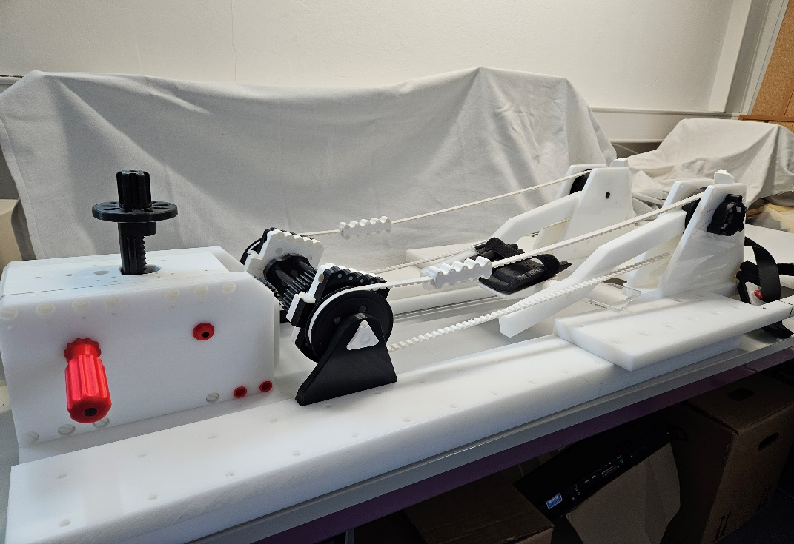
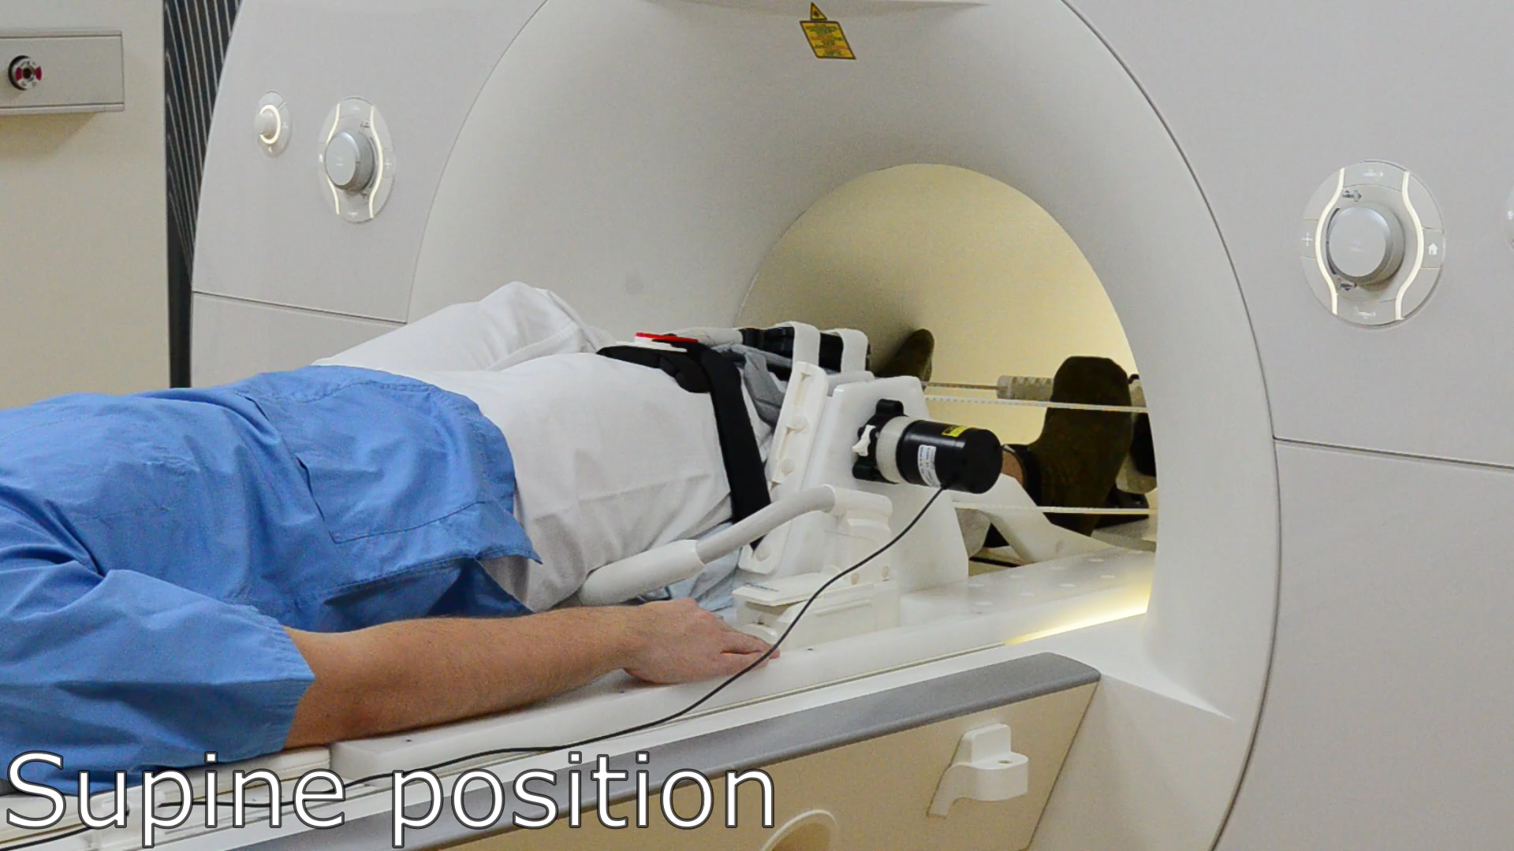

The Setup
Jena | 25.10.2024 | Aayush Nepal
Notes:
This device was developed (a few years ago) in collaboration with our partners at Charite Berlin

Slide 5
Knee flexion-extension device
Repeated active open-chain knee flexion-extension exercise
5 volunteers
Guided by the beat of a metronome at 60 bpm
Once without additional weight and once with 12 kgs
Each scan lasted a duration of 160 seconds
Range of motion achieved within the scanner ~(30-46)°
Jena | 25.10.2024 | Aayush Nepal
Notes:
This device was developed (a few years ago) in collaboration with our partners at Charite Berlin

Slide 6
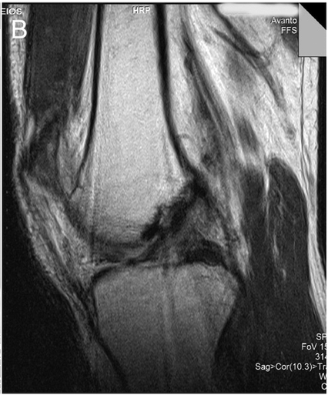
Imaging sequence and acquisition
Imaging the moving knee: Not your typical MRI setup.
Generally, we want to avoid movement inside the scanner.
A few different things allow us to overcome this challenge:
Lavdas 2012, doi:10.1016/j.mri.2012.04.001
Jena | 25.10.2024 | Aayush Nepal

Slide 7
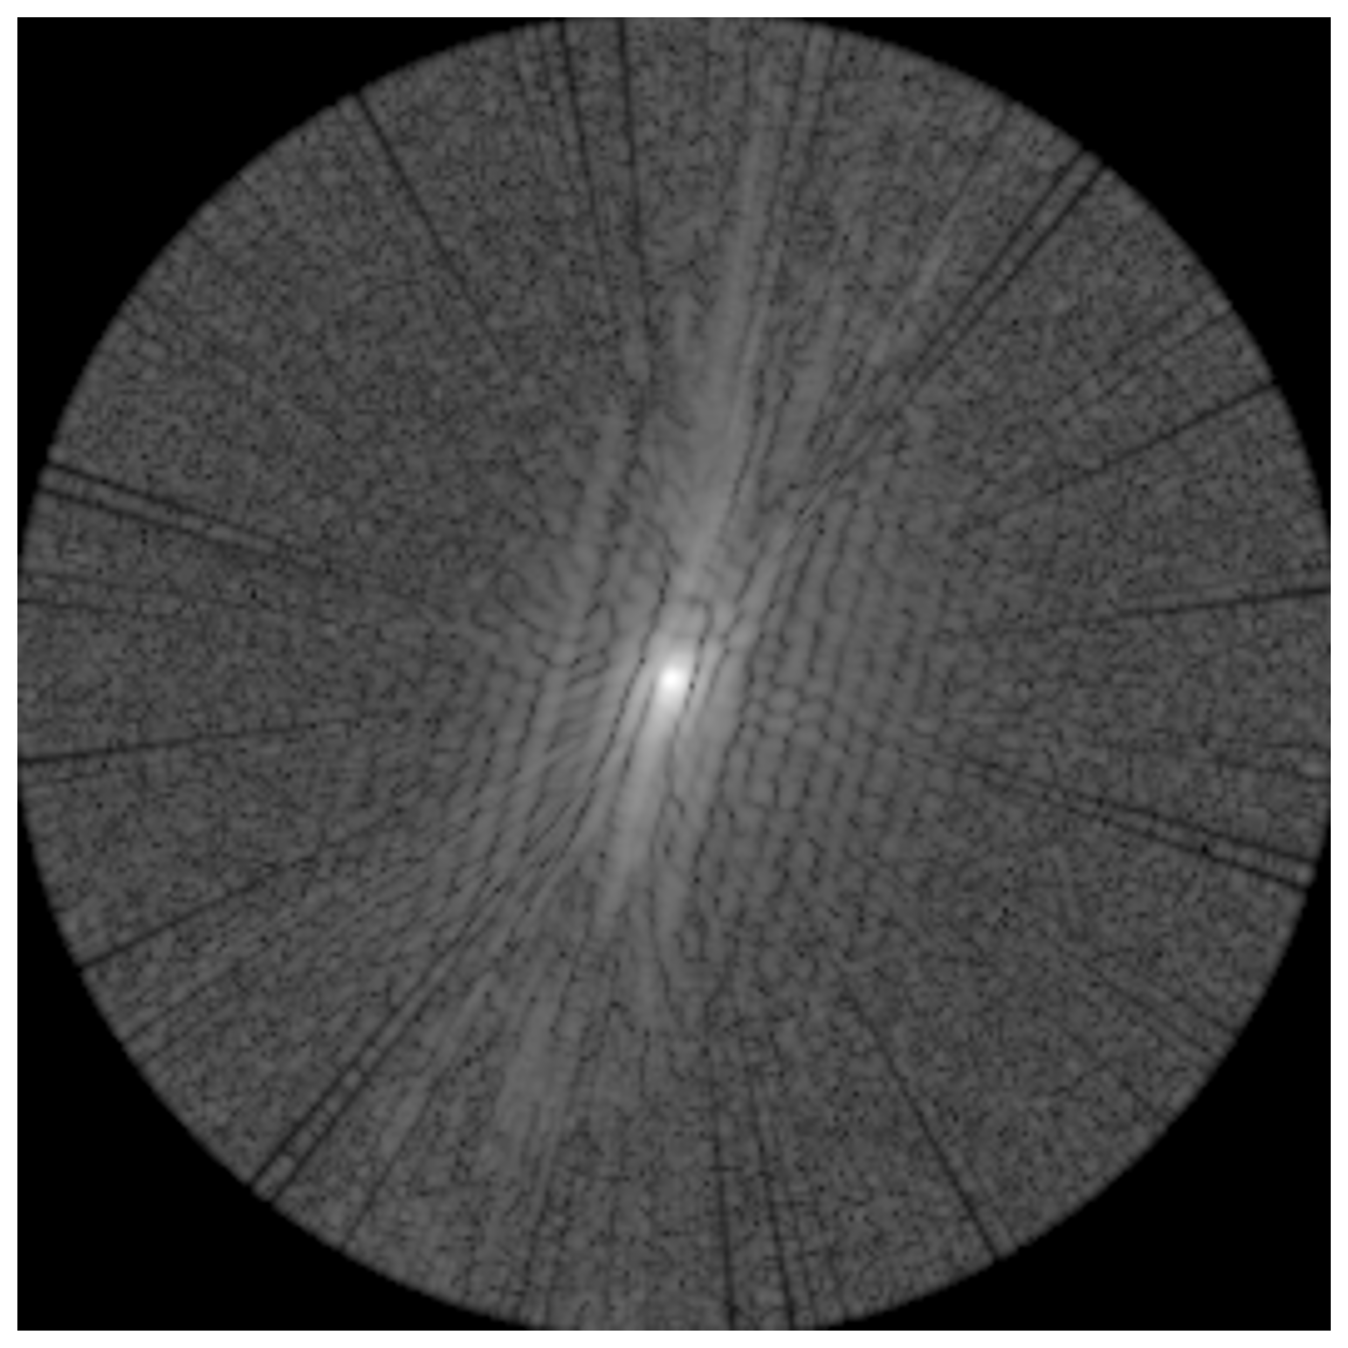
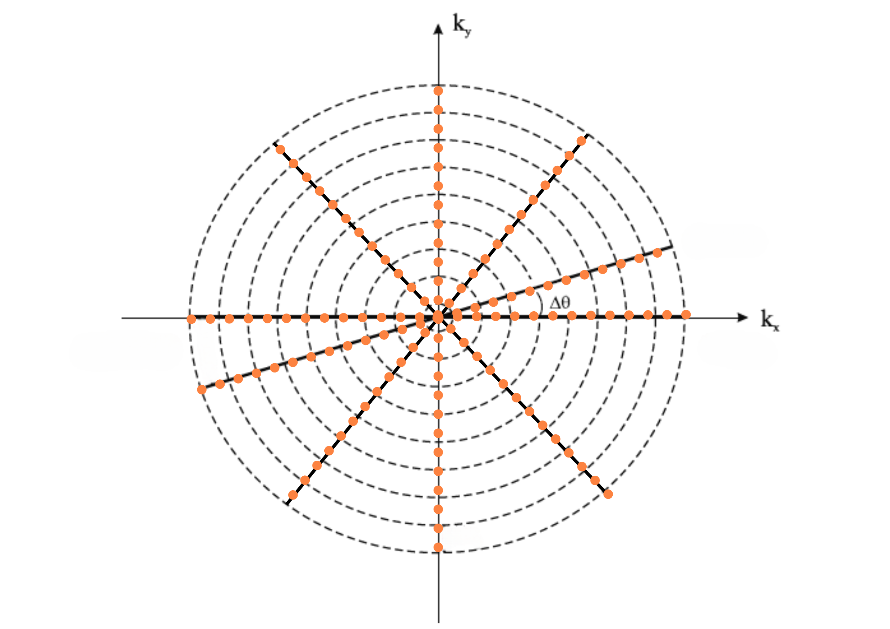
Imaging sequence and acquisition
Imaging the moving knee: Not your typical MRI setup.
Generally, we want to avoid movement inside the scanner.
A few different things allow us to overcome this challenge:
Non-cartesian sampling of k-space: Radial Golden-Angle
Speed!: Gradient Echo FLASH: Small flip angle allows for shorter repetition times
Syncing and CINE:
Each k-space contains data across a range of flexion angles
Optical fibre position sensor samples the knee flexion precisely (0.0025°)
Scanner data is synchronized with optical sensor data using trigger signals
K-space data is sorted into 2-degree knee angle intervals
A ‚cinema‘ or ‚movie‘ of the knee motion is created
Jena | 25.10.2024 | Aayush Nepal

Slide 8
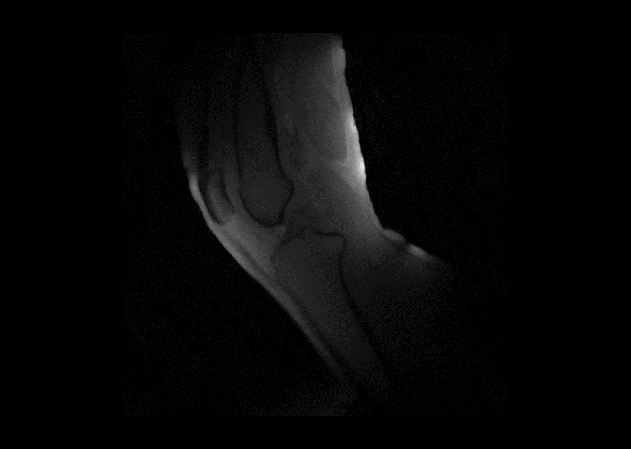
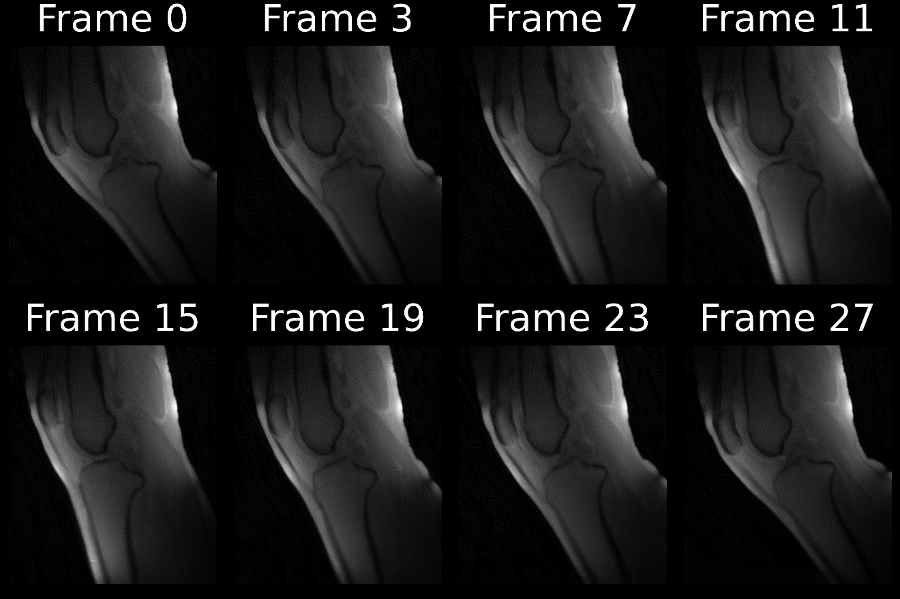
Reconstructed frames

Slide 9
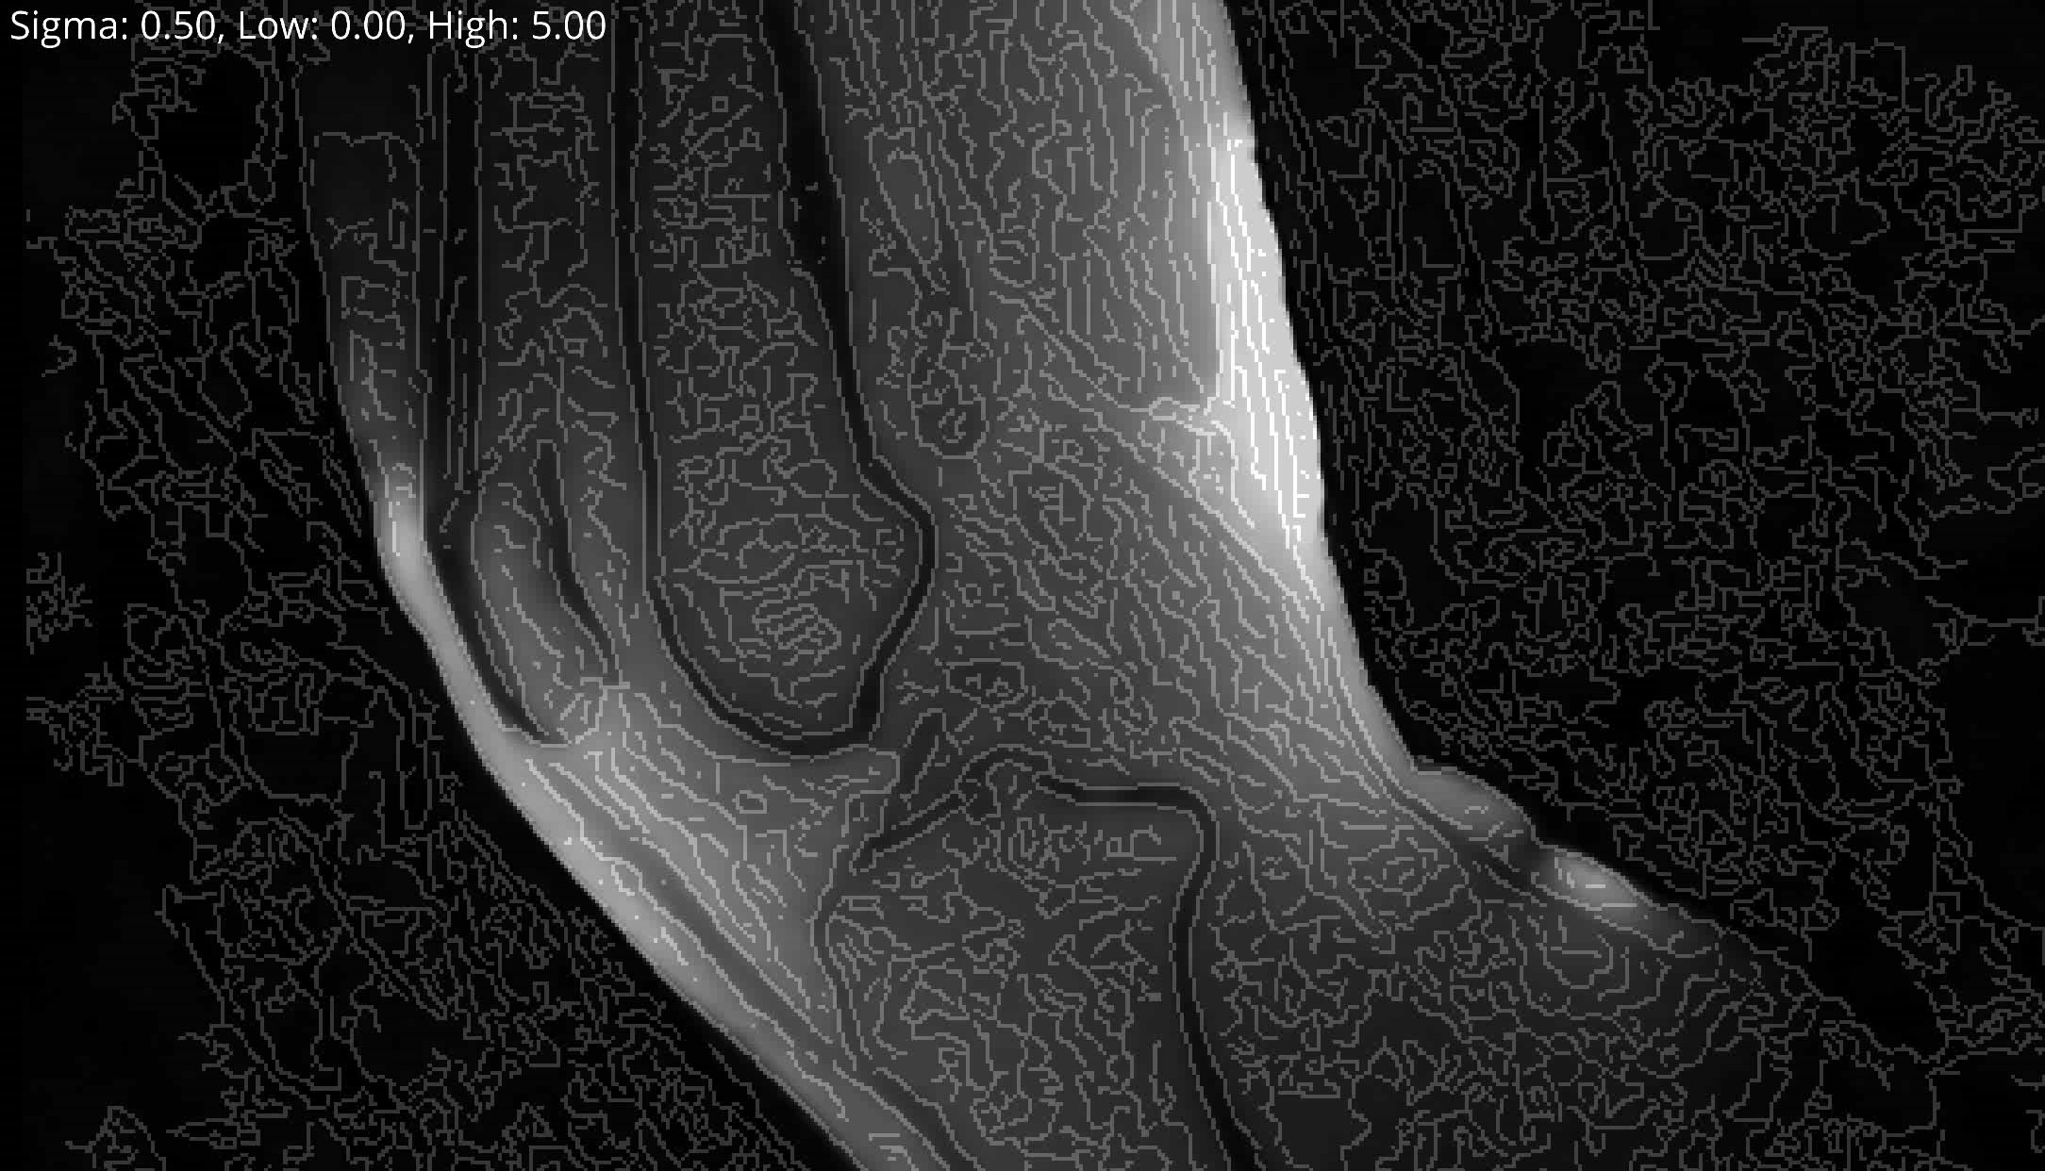
Methods: Edge Detection
Hystereses Thresholding (Pixels and their gradient magnitude)
Strength of gaussian blur
Low Threshold: lower values are discarded (not an edge)
High Threshold: values higher are ‘Strong Edges’
In Between: ‘Weak Edges’ Only kept if connected to a strong edge

Slide 10
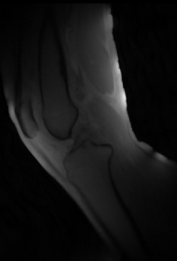
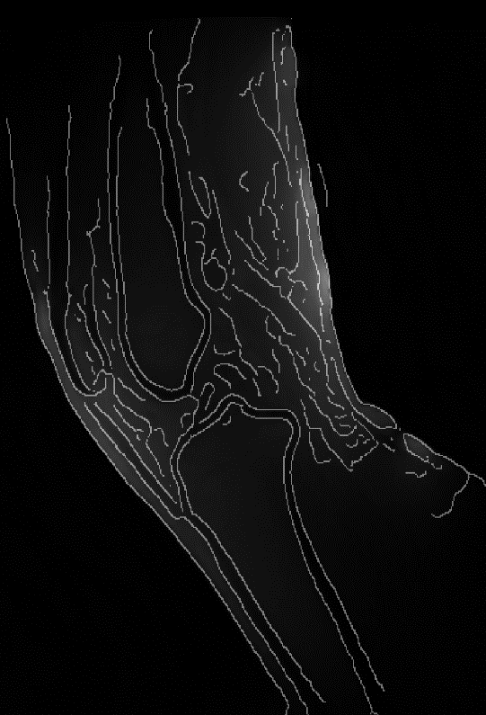
Methods: Edge Detection
Jena | 25.10.2024 | Aayush Nepal

Slide 11
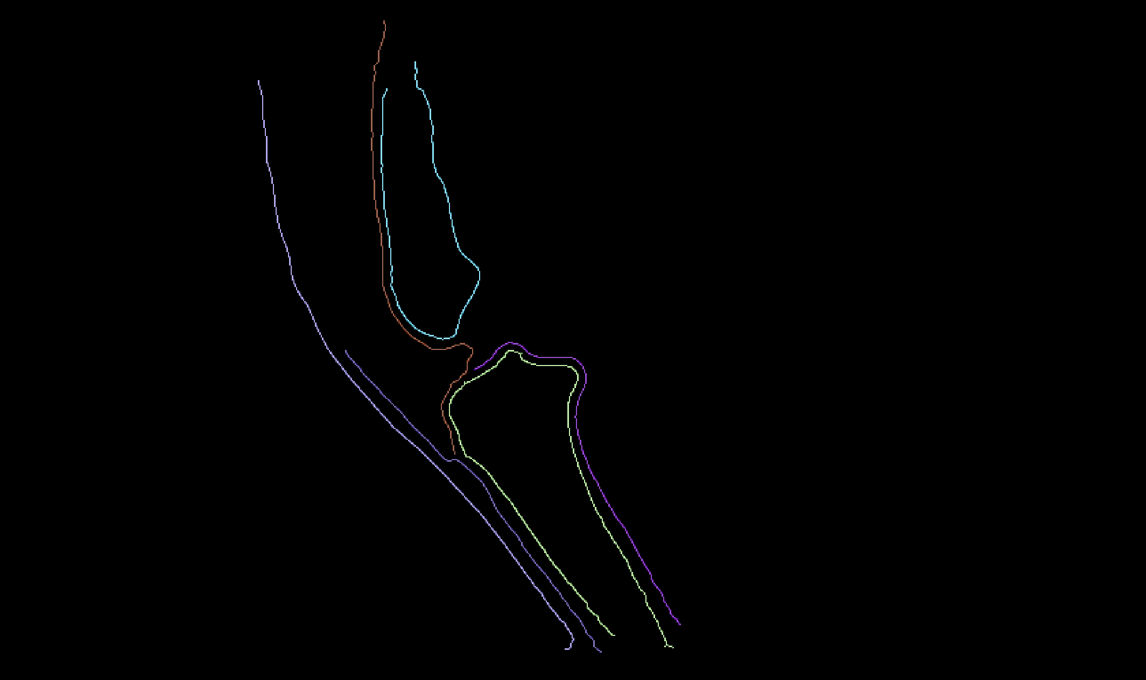
Methods: Connected Component Labelling
Treated the series of 2d arrays as a 3d volume.
3 × 3 × 3 structuring element
26-way connectivity
+
Skeletonization
+
Jena | 25.10.2024 | Aayush Nepal
Remove small objects

Slide 12
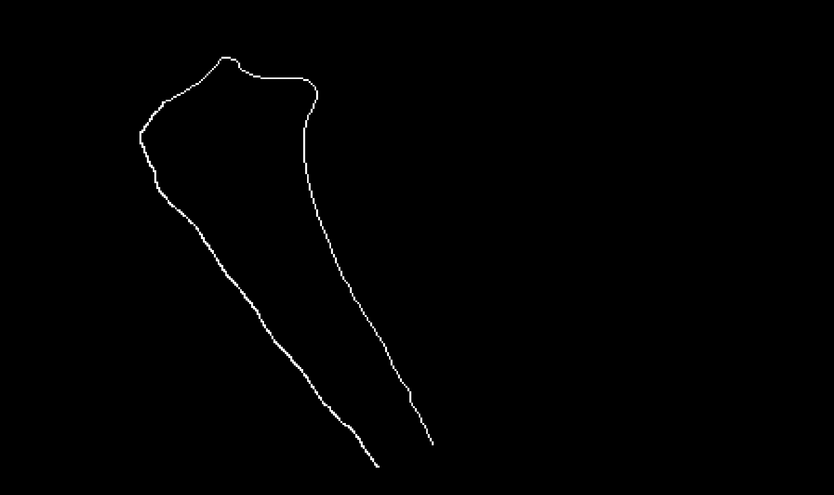
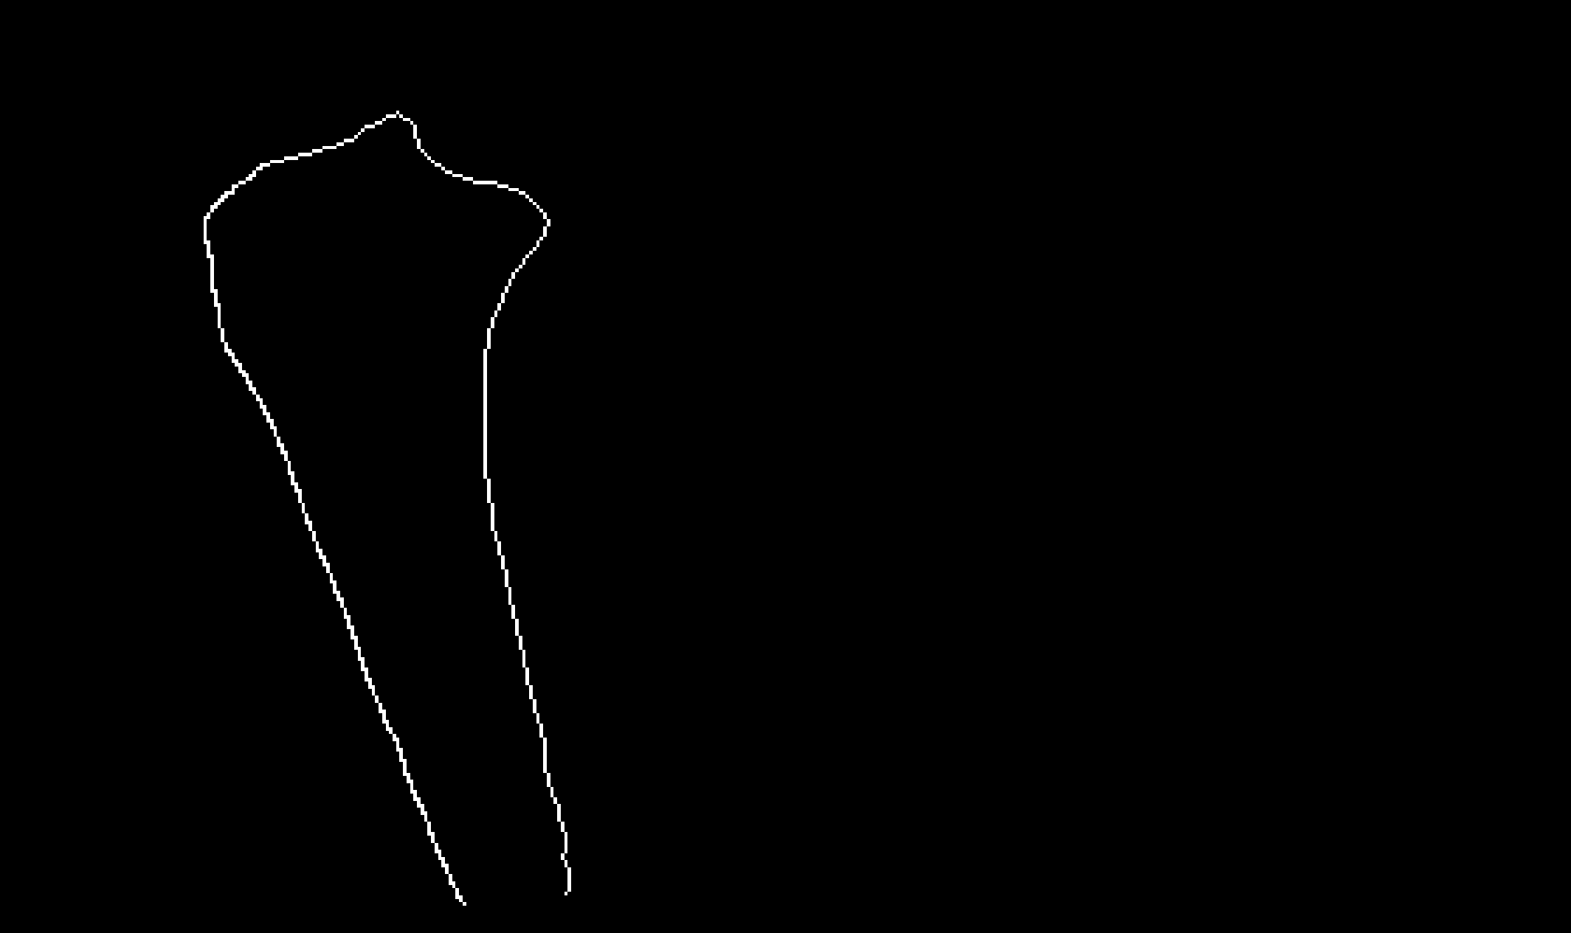
Methods: Example sets
SET R
SET Q
?
Jena | 25.10.2024 | Aayush Nepal

Slide 13
Methods: Issues with raw coordinates
SET R
SET Q
Inefficient computation
?
Lack of correspondance
Order matters
Inconsistent sampling
Uneven number of points
Jena | 25.10.2024 | Aayush Nepal

Slide 14
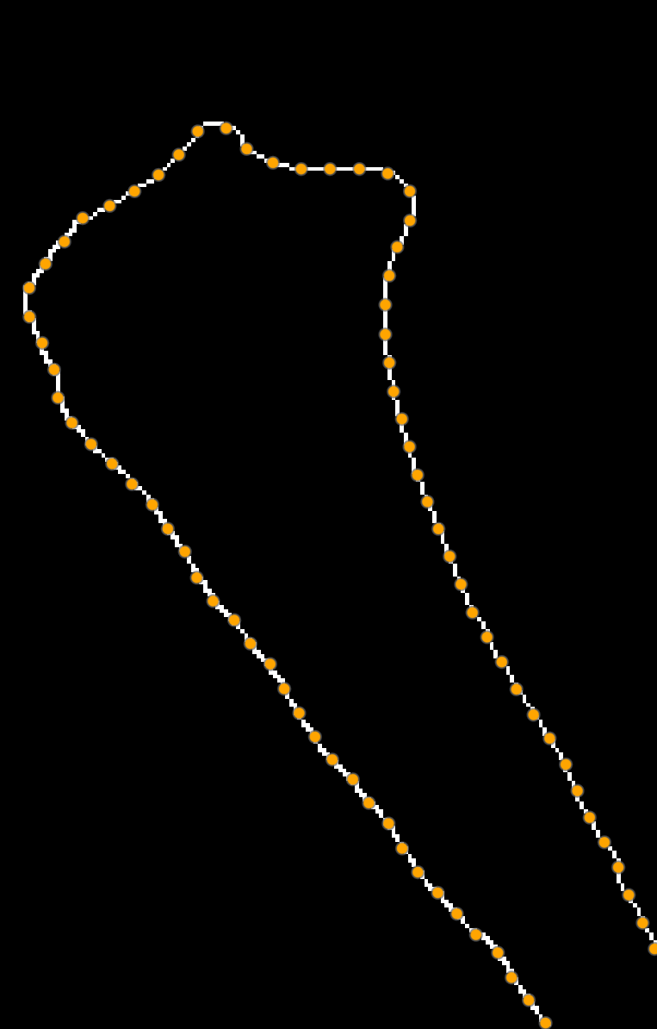
Methods: Sorting and Downsampling
SET R SET P
Sorting:
most distal and posterior point for the tibia, most proximal for the femur
nearest neighbor approach to create an ordered path
2. Cubic Spline Interpolation:
create a smooth, continuous curve that passes through all points in ordered set R
parameterize the curve using arc length
3. Downsampling and point placement
Equal interval = total arc length of spline / desired number of points
place points along the spline at these equal arc length intervals
Jena | 25.10.2024 | Aayush Nepal

Slide 15
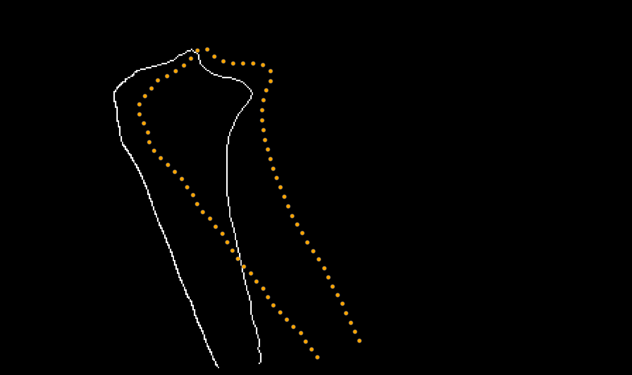
Methods: Alignment of Set P to Q
SET P
SET Q
?
Jena | 25.10.2024 | Aayush Nepal

Slide 16


Methods: Rigid Transformation for Edge Tracking
A point in set P (x,y) undergoes the following transformation:
$$\left[\begin{matrix}x′ \\ y′\end{matrix}\right]=R\left(φ\right)\left[\begin{matrix}x \\ y\end{matrix}\right]+\left\lceil \begin{matrix}Δx \\ Δy\end{matrix}\right\rceil$$
where, R(ϕ) is the 2D rotation matrix: $\left[\begin{matrix}\cos{φ} & −sin{φ} \\ \sin{φ} & \cos{φ}\end{matrix}\right]$
And (Δx,Δy) are the translations in the sagittal plane.
Optimize for: (Δx,Δy, $φ$)
2. A cost function that quantifies the misalignment between each ($x′$, y$′$) and its nearest neighbour in set Q.
$$C\left(Δx, Δy, φ\right)= \sum_{p=1}^{N}{\min_{qεQ}\left(\sqrt{{\left(x_{q}−{x′}_{p}\right)}^{2}+{\left(y_{q}−{y′}_{p}\right)}^{2}}\right)}$$
Set P
Set Q
Jena | 25.10.2024 | Aayush Nepal

Slide 17
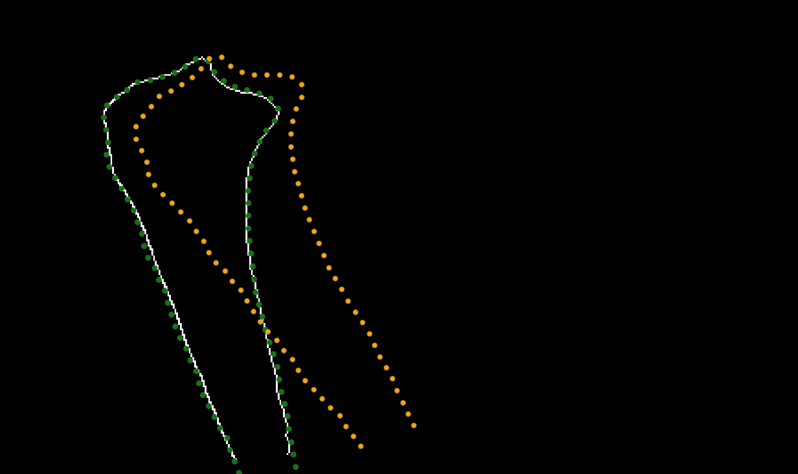
Methods: Rigid Transformation for Edge Tracking
Frame-by-frame transformation. Each transformed frame is used as reference for the next.
Nelder-Mead simplex algorithm („fmin search“)
Parameters:
Initial guess: [0,0,0]
Maximum iterations: 1000
Function tolerance and parameter tolerance: 1e-8
Once the set of parameters are obtained, any shape drawn on one frame on the bone will automatically be transformed to the rest of the frames
Set P
Set P‘
Set Q
Jena | 25.10.2024 | Aayush Nepal

Slide 18
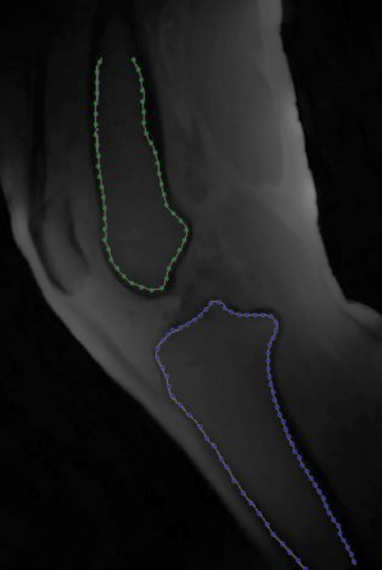
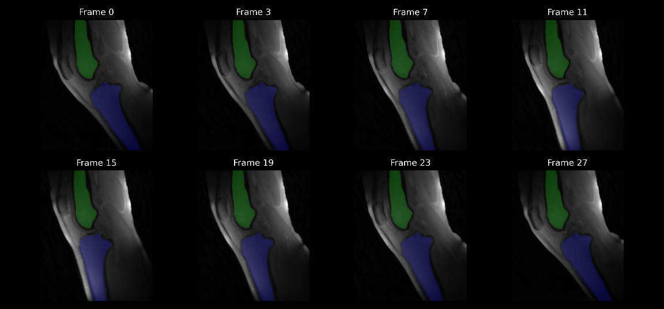
Methods: Applying transformation
Jena | 25.10.2024 | Aayush Nepal

Slide 19
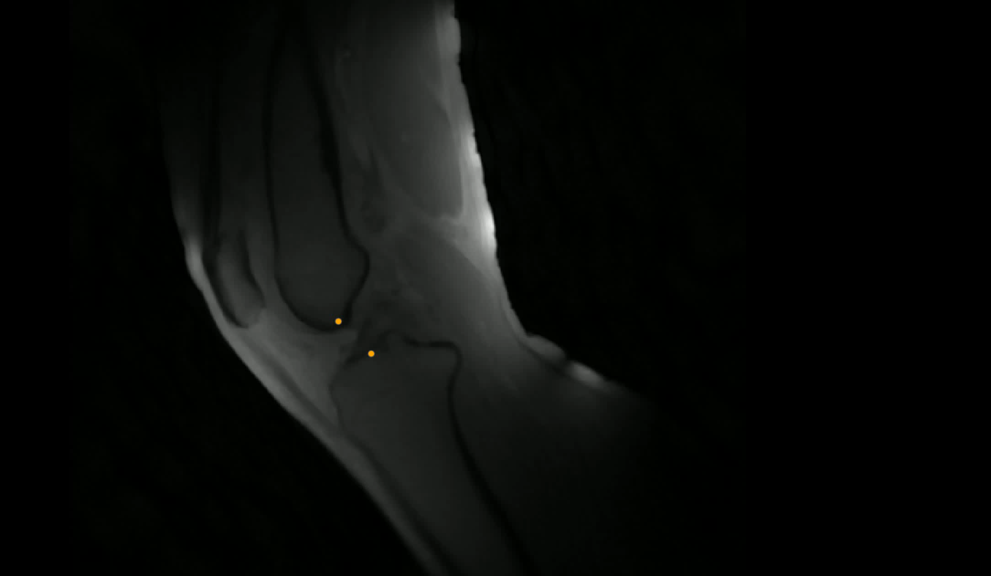
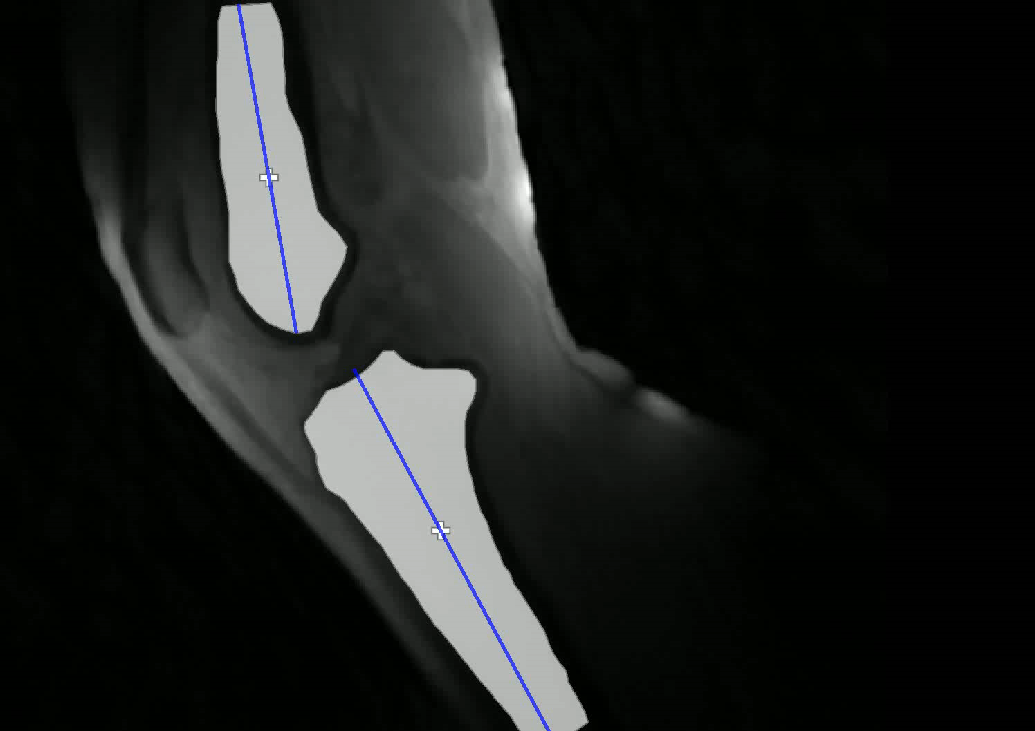
Parameter extraction and tracking
Distance measurement
Angle measurement
Jena | 25.10.2024 | Aayush Nepal

Slide 20
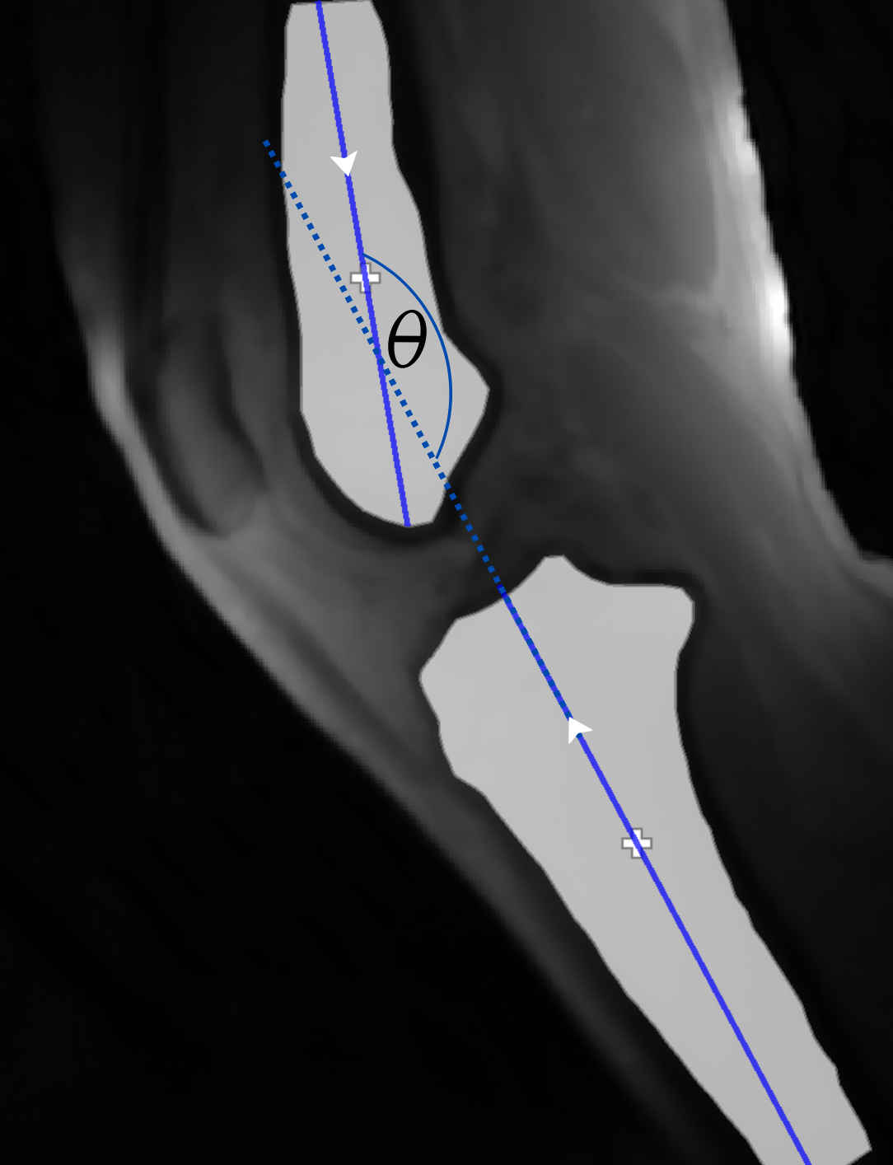
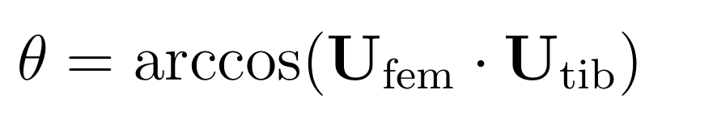
Calculations
Principle Component Analysis (PCA) was used to estimate the long axis of the bone segments.
- PCA identifies the direction of max. Variance
Simple euclidean distance formula was used for distance between the points
The time-axis had to be normalized due to varying ranges of motion of the subject‘s knee flexion angles.
Frames were normalized between -100 to 100 % of flexion.
Aggregation was then done by binning the y values in intervals of 10% flexion
Jena | 25.10.2024 | Aayush Nepal

Slide 21
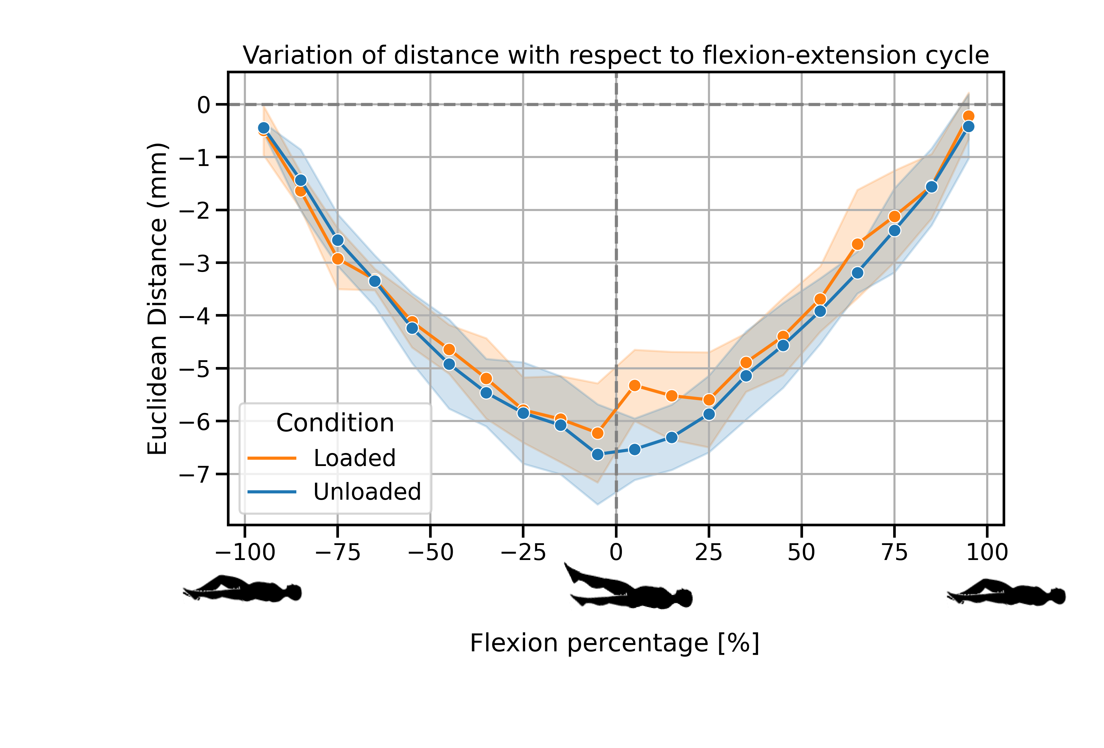
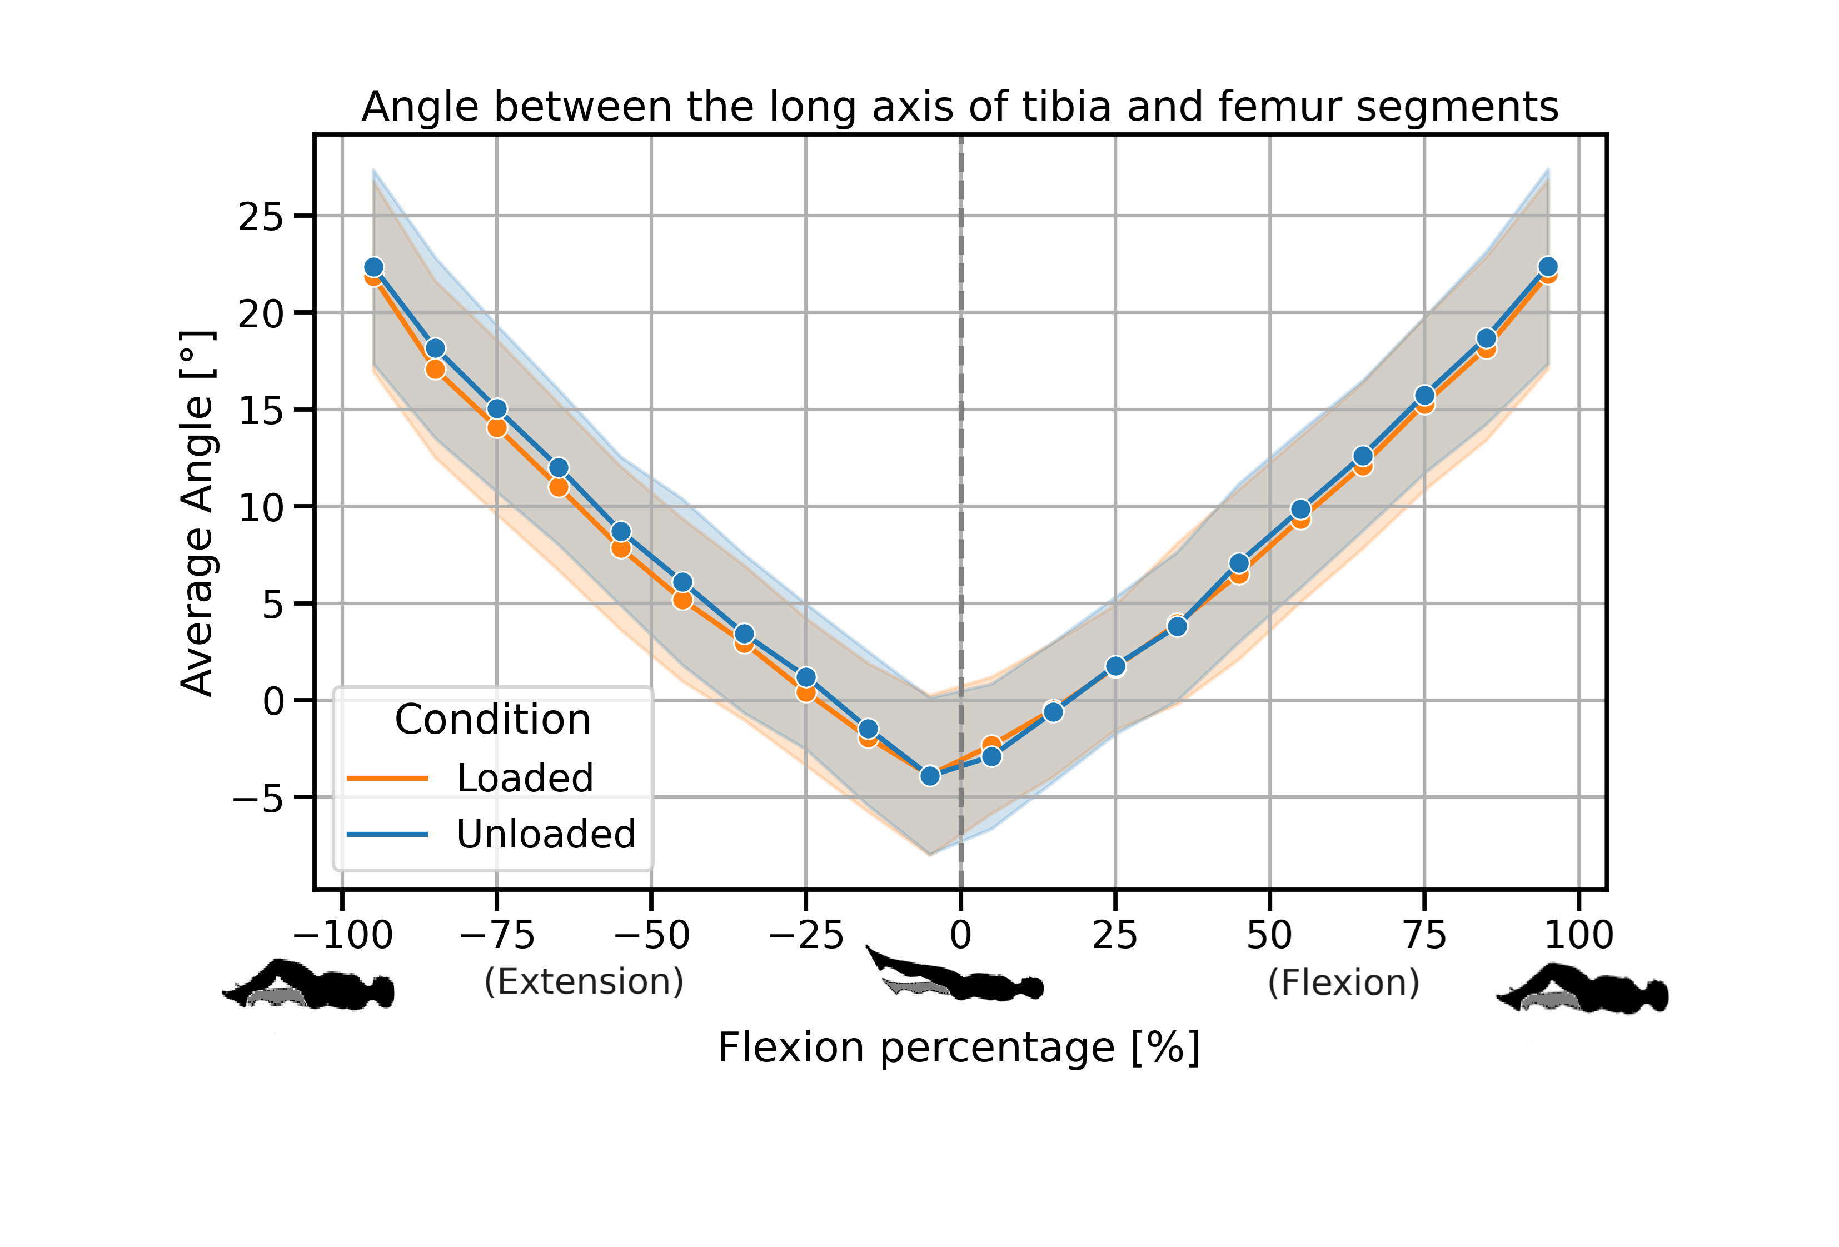
Results
Jena | 25.10.2024 | Aayush Nepal

Slide 22
Results
Significant different observed in the 0-10% flexion range (p=0.0016)
Likely reflects Screw Home Mechanism (SHM) - tibial rotation near terminal extension (Kim et al., 2015)
External loading increases internal tibial rotation magnitude (Myers et al., 2012)
Rotation occurs earlier in flexion cycle under weight-bearing (Johal et al., 2005)
SHM loss observed in OA patients even without external load (Jeon et al., 2020)
OA patients may show altered distance patterns, especially in early flexion
Quadriceps weakness, a risk factor for OA (Segal et al., 2011), may affect loading response
Jena | 25.10.2024 | Aayush Nepal

Slide 23
Conclusion and Outlook
No significant differences were found in the angle measurements between loaded and unloaded measurements
There was a significant differnce (P=0.016) in early flexion phase.
Normative trends can be established with more healthy volunteers
Same volunteers should be re-measured to assess self-consistency
Patella can be tracked in a similar manner to extract patellofemoral kinematics too
A multi-slice approach could be adapted for 3d datasets for a more comprehensive 3d kinematic analysis
Jena | 25.10.2024 | Aayush Nepal

Slide 24

Thank you for your attention!
Jena | 25.10.2024 | Aayush Nepal

Slide 25
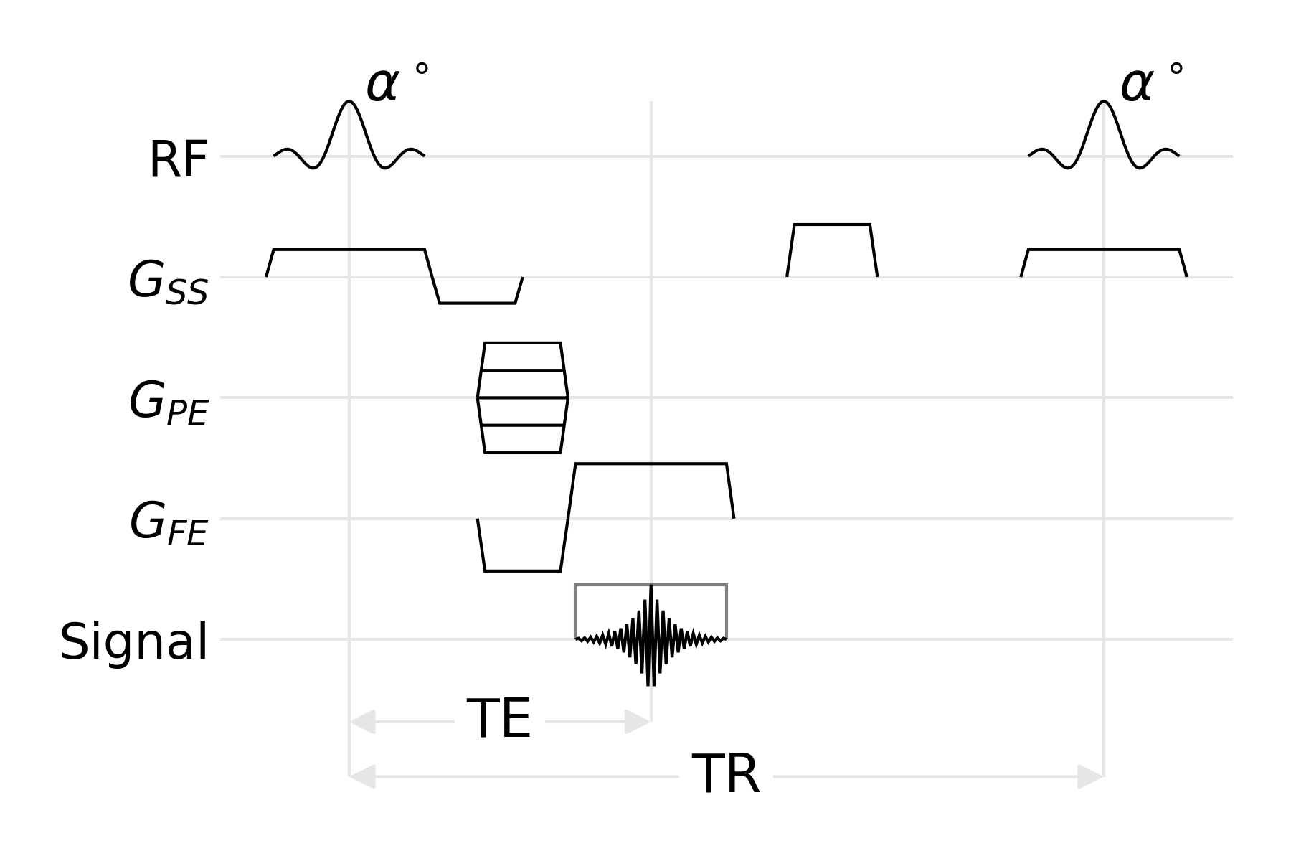
Supplementary materials
Jena | 25.10.2024 | Aayush Nepal

Slide 26
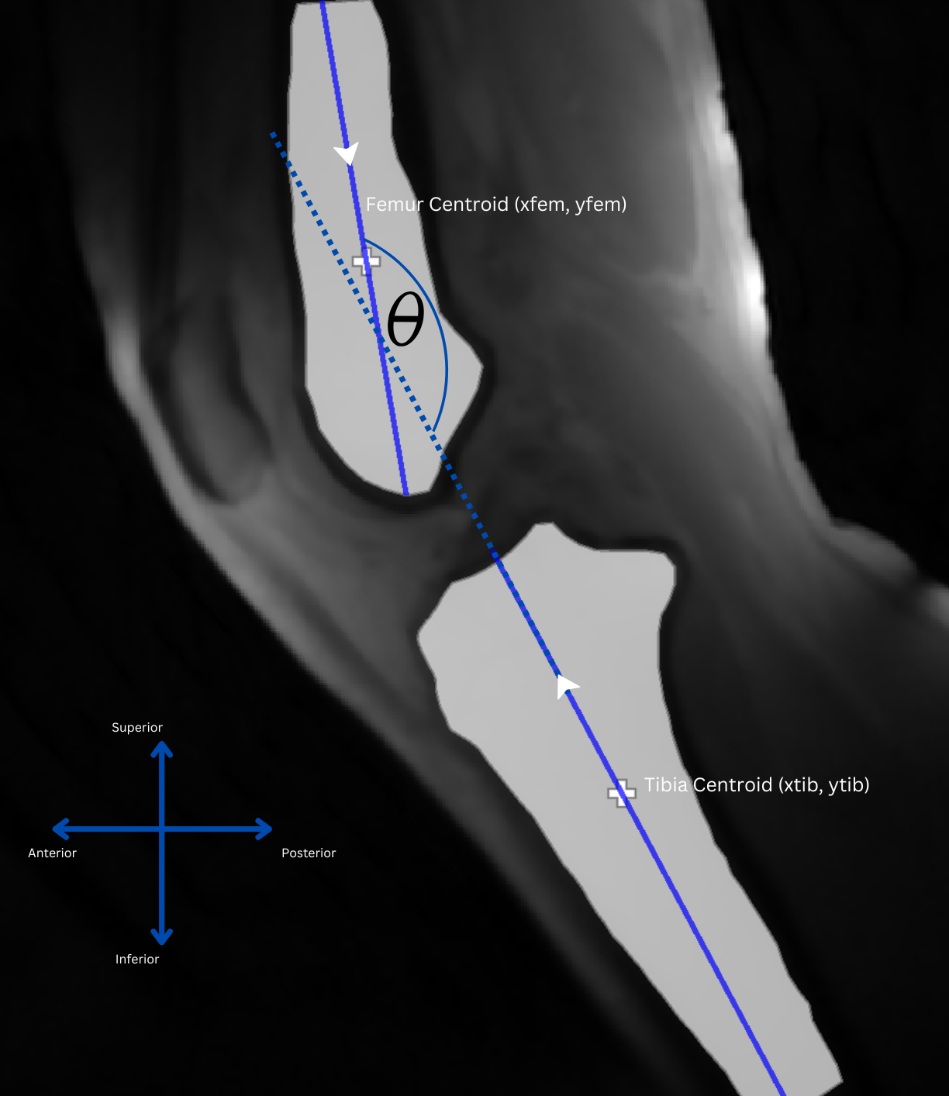
Supplementary materials
Jena | 25.10.2024 | Aayush Nepal

Slide 27
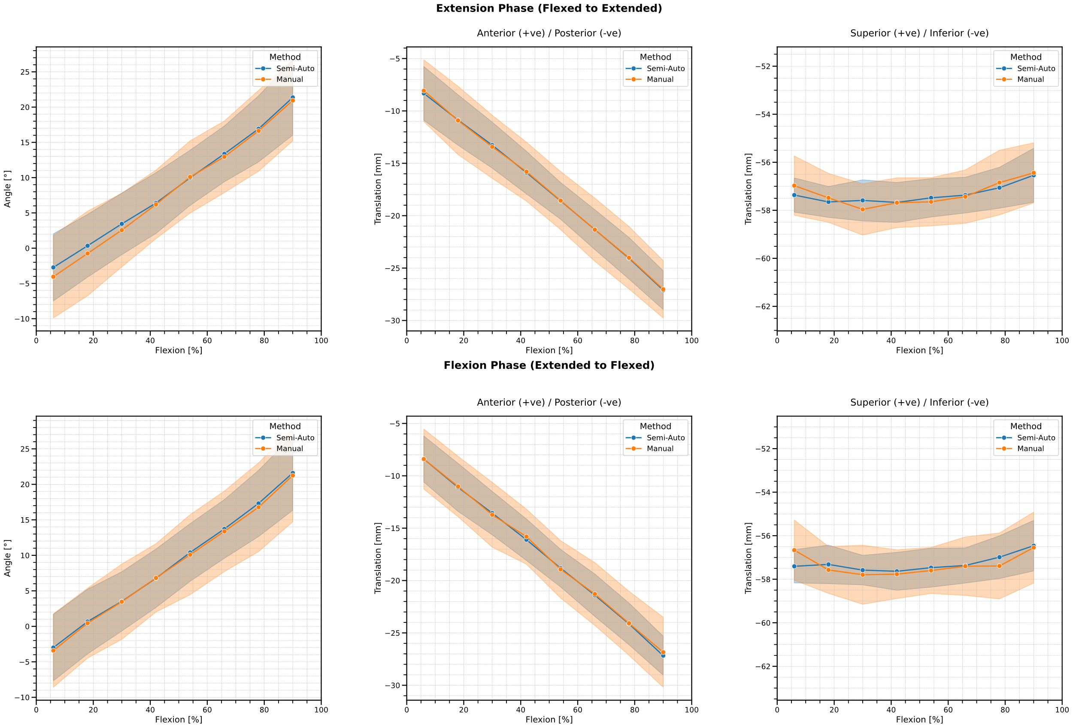
Supplementary materials
Jena | 25.10.2024 | Aayush Nepal

